Slide 1
Lab 4
The last action potential day!

Slide 2
Today’s Topics
Refractory Period
The Calcium Action Potential
The Neuromuscular Junction
Interactions of Synaptic Potentials

Slide 3
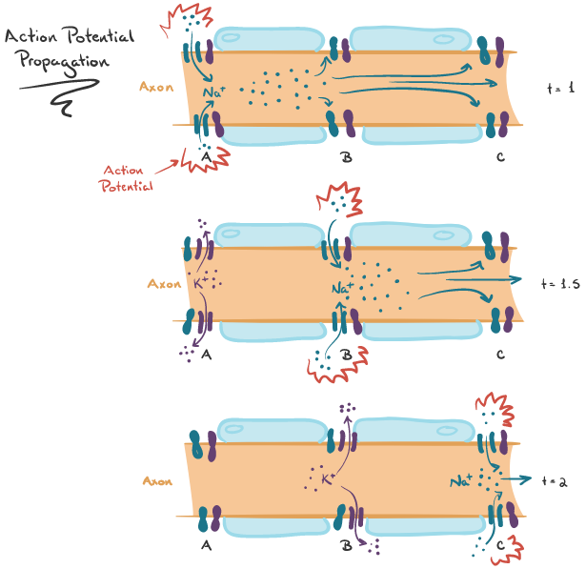
Why is flow down an axon unidirectional?
Notes:
because a patch of membrane that has just undergone one action potential is in a “refractory period” and cannot undergo another.

Slide 4
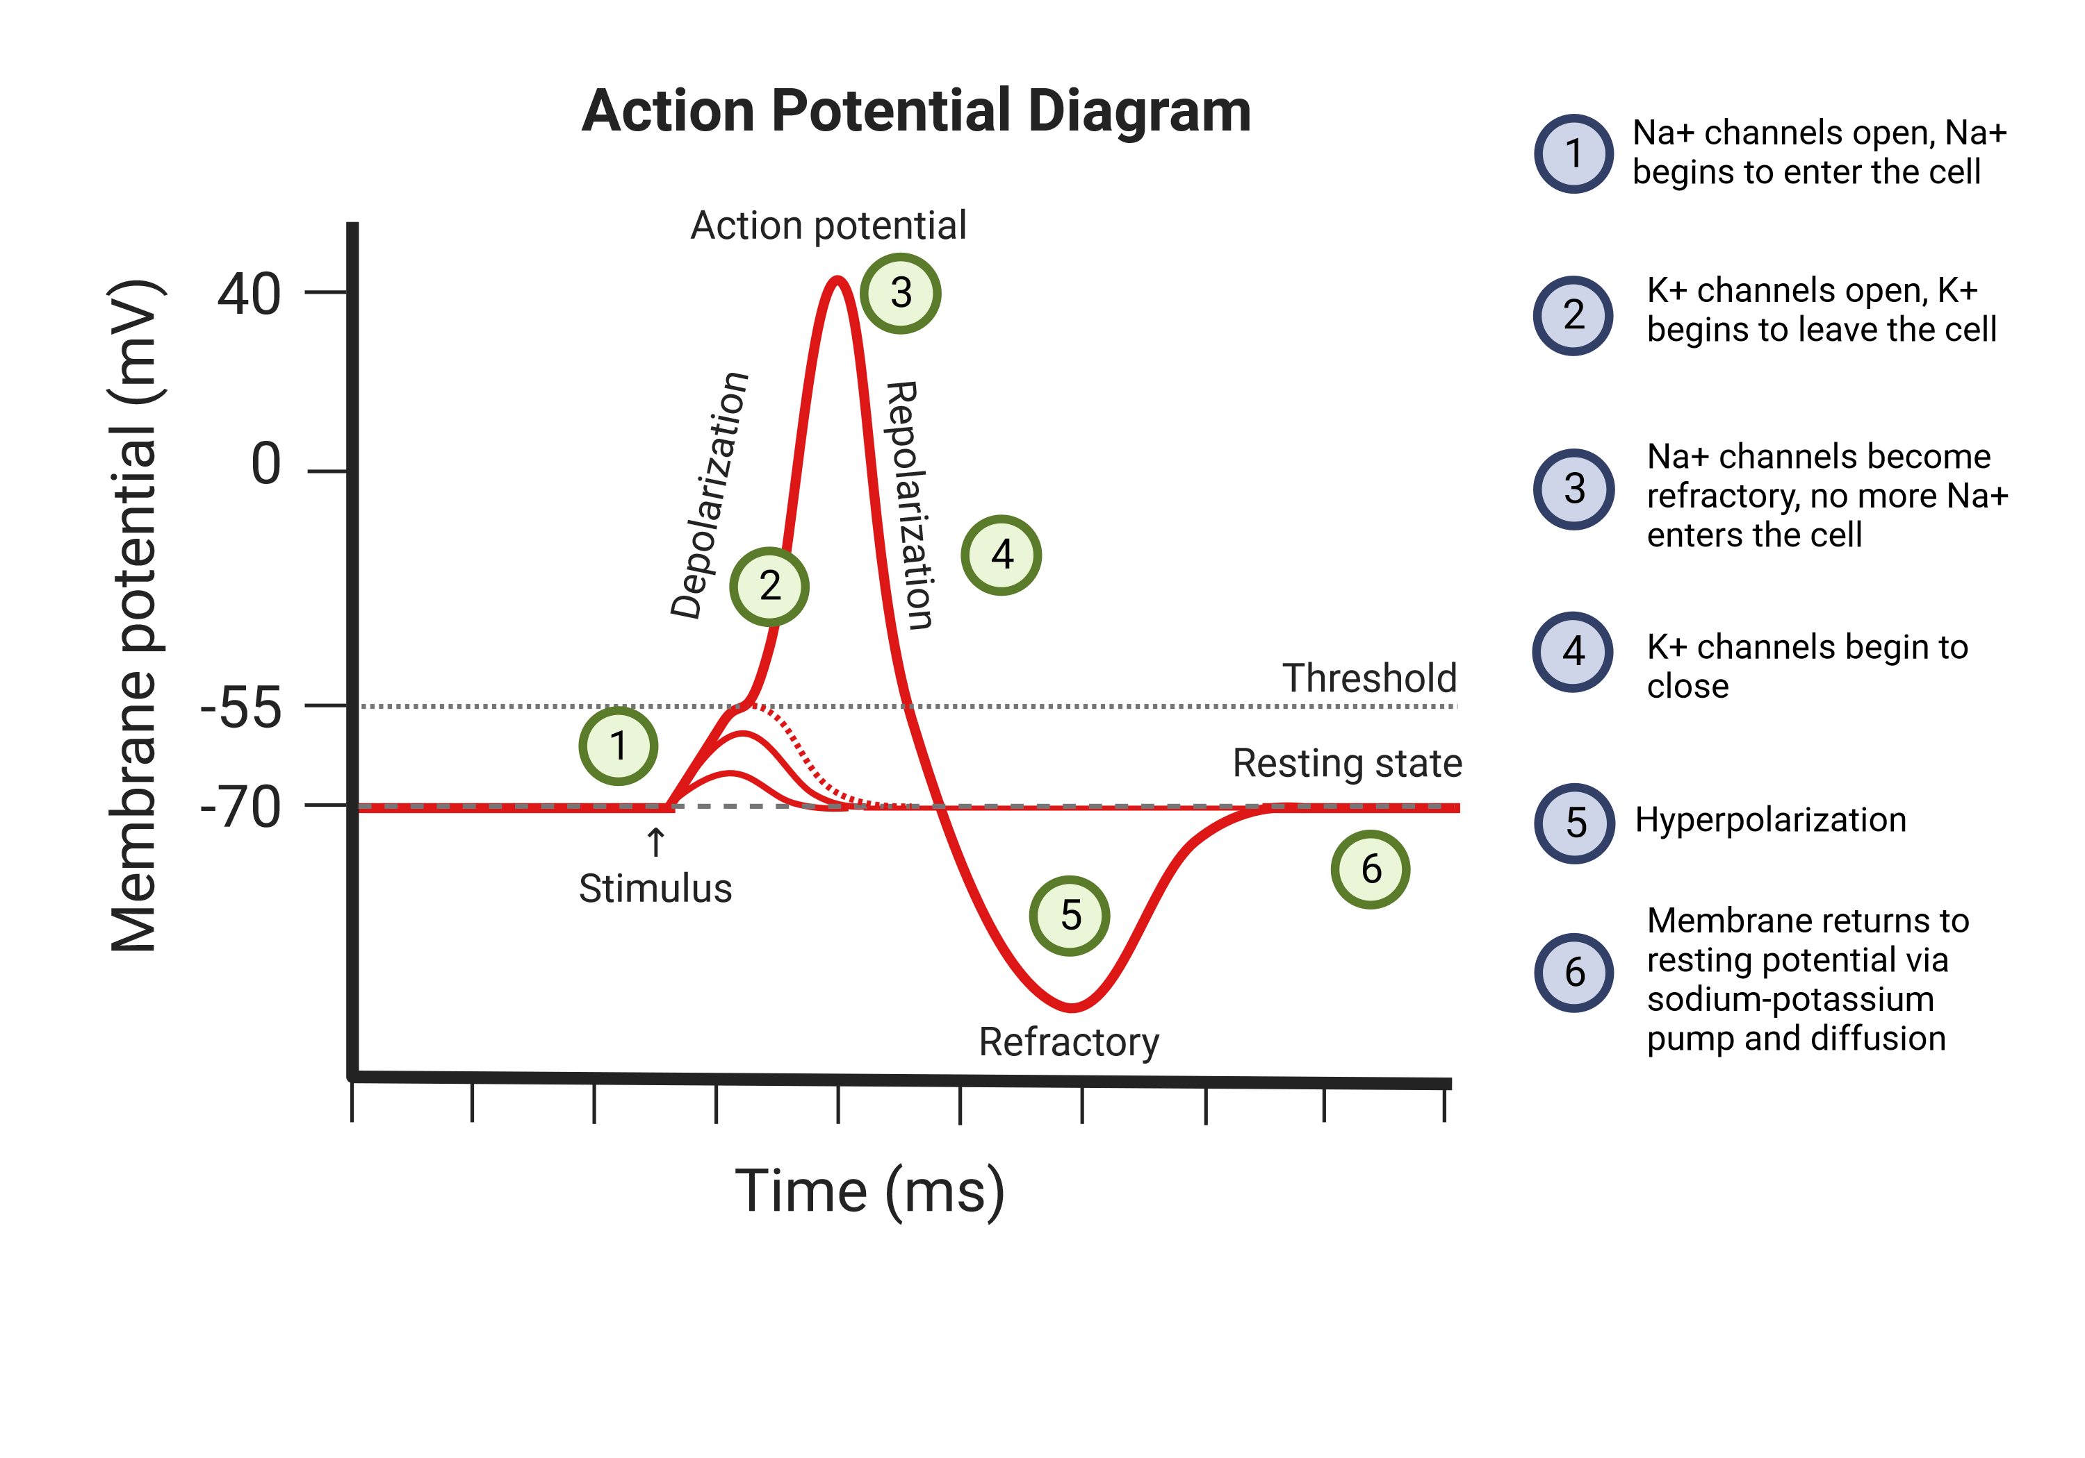
The Refractory Period
From the Latin refractarius, which means “obstinate, stubborn”
Once an action potential has begun, a second action potential cannot be triggered for about 1-2 msec. No matter how large the stimulus.
This delay represents the time required for the Na+ channel gates to reset to their resting positions
But if these voltage gated sodium channels open with an increase in membrane potential, how do they also close at this potential?

Slide 5
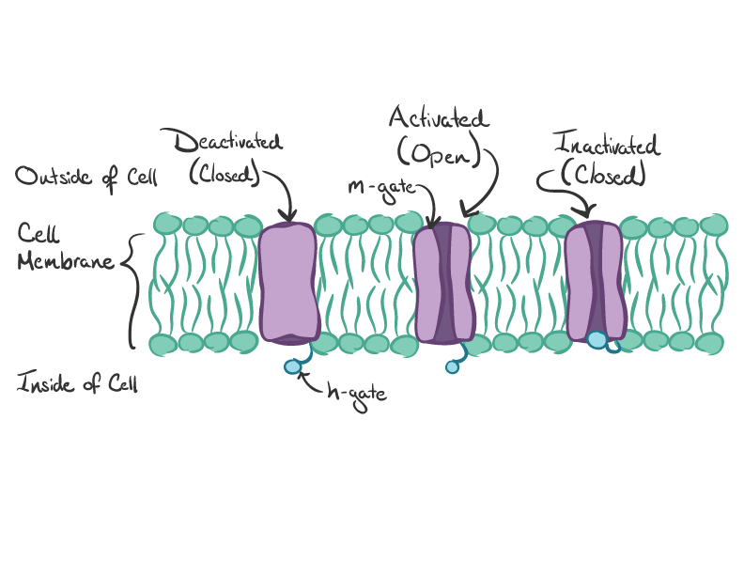
Na+ Channels
Have 2 Gates
At the resting membrane potential, the activation gate (m-gate) closes the channel
A depolarizing stimulus opens the activation gate
Na+ enters the cell when the activation gate opens, and the cell becomes more positive
When the cell becomes more positive on the inside, the inactivation gate closes (h-gate)
Na+ can no longer enter the cell
During repolarization, both gates reset to their original positions (close activation gate, open inactivation gate)

Slide 6
The Relative Refractory Period
Follows the absolute refractory period
To stimulate an action potential during this period, must contend with 2 events:
Some but not all the Na+ gates have reset to their original positions
K+ channels are still open
So, the threshold for an action potential is closer to zero, which requires a stronger stimulus to reach
The action potential created will be of smaller amplitude than normal because of K+ channels still being open

Slide 7

The Calcium Action Potential

Slide 8
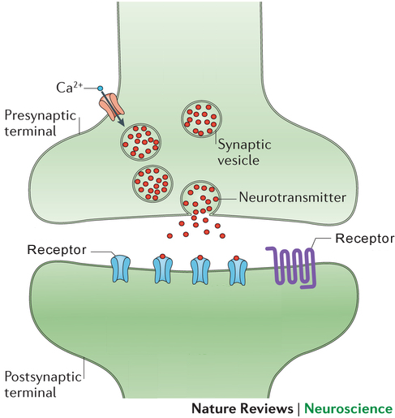
Cell types and function
Endocrine cells for the secretion of hormones
Neuronal cells for neurotransmitter release
Visual transduction in rod photoreceptors
Muscle Contraction (cardiac, skeletal, smooth)
Cardiac pacemakers (autorhythmic cells)
Notes:
https://www.researchgate.net/figure/Representative-action-potentials-APs-of-a-neuron-and-ventricular-myocyte-Note-the_fig2_226655066

Slide 9
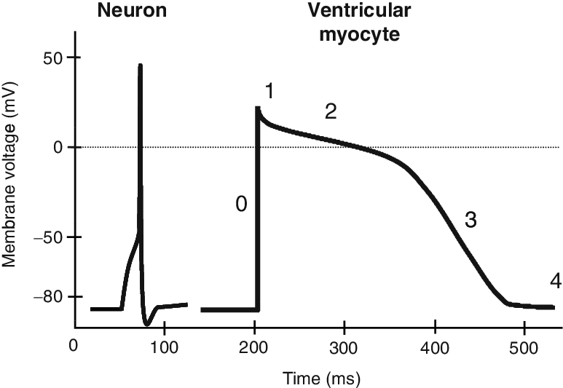
Difference Between
Na+ and Ca++
Action Potentials
L-type Ca++ channels take a long time to open and then stay open longer.
Ca++ currents are slower and more prolonged than Na+ currents.
A typical action potential in a neuron or skeletal muscle fiber lasts between 1 and 5 msec. In a contractile myocardial cell, the action potential typically lasts 200 msec or more.
K+ is exiting during Ca++ entry. The action potential height is shorter.
Notes:
https://www.researchgate.net/figure/Representative-action-potentials-APs-of-a-neuron-and-ventricular-myocyte-Note-the_fig2_226655066

Slide 10
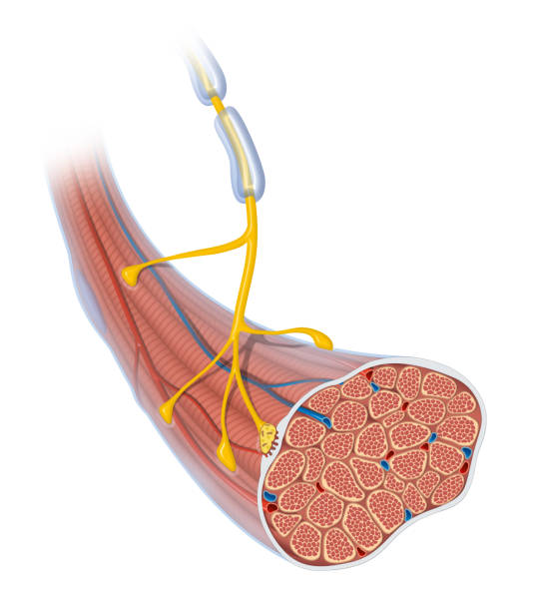
The Neuromuscular Junction

Slide 11
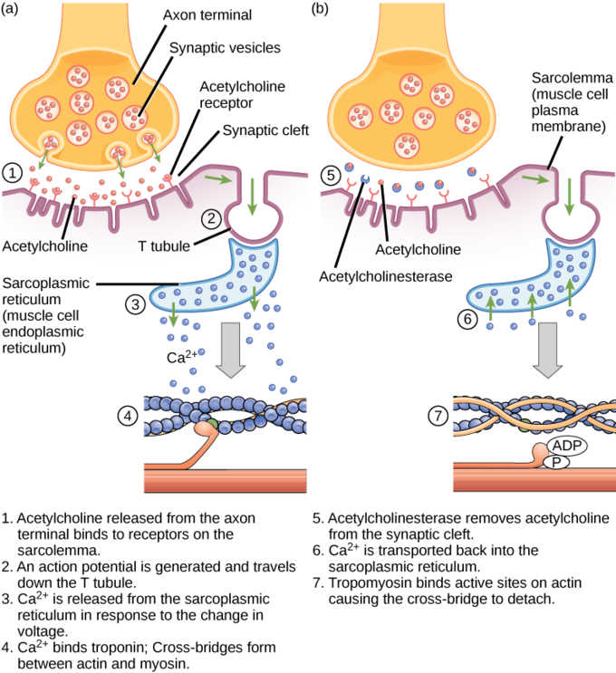
The NMJ
A synaptic connection between the terminal end of a motor nerve and a muscle
Acetylcholine is released from the synaptic terminal
Binds to postsynaptic, nicotinic receptors, causing Na+ influx, K+ efflux of muscle fiber (Na+ influx greater, so depolarizes cell)
Causes a postsynaptic “end plate current” to induce an “end plate potential” in the muscle fiber
The end plate potential induces an action potential, which propagates along the muscle fiber

Slide 12
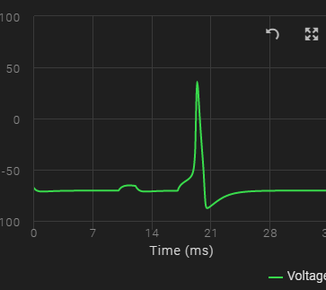
The NMJ
The end plate potential in the muscle cell is equivalent to the graded potentials in neurons
The action potential then propagates along the muscle fiber

Slide 13
Interactions of Synaptic Potentials

Slide 14

Post Synaptic Potentials
Excitatory Post Synaptic Potentials (EPSP) – is a postsynaptic potential that makes the postsynaptic neuron MORE likely to fire an action potential.
EPSPs in the CNS are primarily due to glutamate or acetylcholine
Can involve Na+, K+, and Ca+
EPSPs are graded (i.e., they have an additive effect)

Slide 15
Post Synaptic Potentials
Inhibitory postsynaptic potential (IPSP) is a kind of synaptic potential that makes a postsynaptic neuron LESS likely to generate an action potential.
In the CNS are primarily due to GABA
Can involve Na+, K+, and Cl-
IPSPs are graded (i.e., they have an additive effect)

Slide 16
Integration
When multiple EPSPs occur close in time and space their combined effect is the sum of the individual EPSPs
EPSPs and IPSPs compete with each other at numerous synapses of a neuron
This determines whether or not the action potential is generated at the postsynaptic membrane

